Slide 1


LOCALE STORE AND SERVICES MANAGEMENT

Slide 2
Problem Statement
KNOW YOUR LOCAL!
­­Having multiple online store informs us about the items available in their warehouses but it does not tells us is what is available in local store.
E-COMMERCE VS LOCAL STORES
Local stores have also been affected due to heavy online shopping from ecommerce.
QUICK ACCESS AND DELIVERY
Also, customers nowadays require a quick delivery of item to their house which isn’t made possible by these ecommerce websites and even if they provide it they charge a lot of money for the delivery.
REQUIRE HOUSEHOLD SERVICES?
Moreover, if a customer is new to a place they are not aware of household services.

Slide 3
Approach
Network
Boston
Consider a network in an ecosystem specifying an area (for e.g. Boston).
Whenever a Customer registers into the system, he/she gets assigned into the network based on their location.

Slide 4

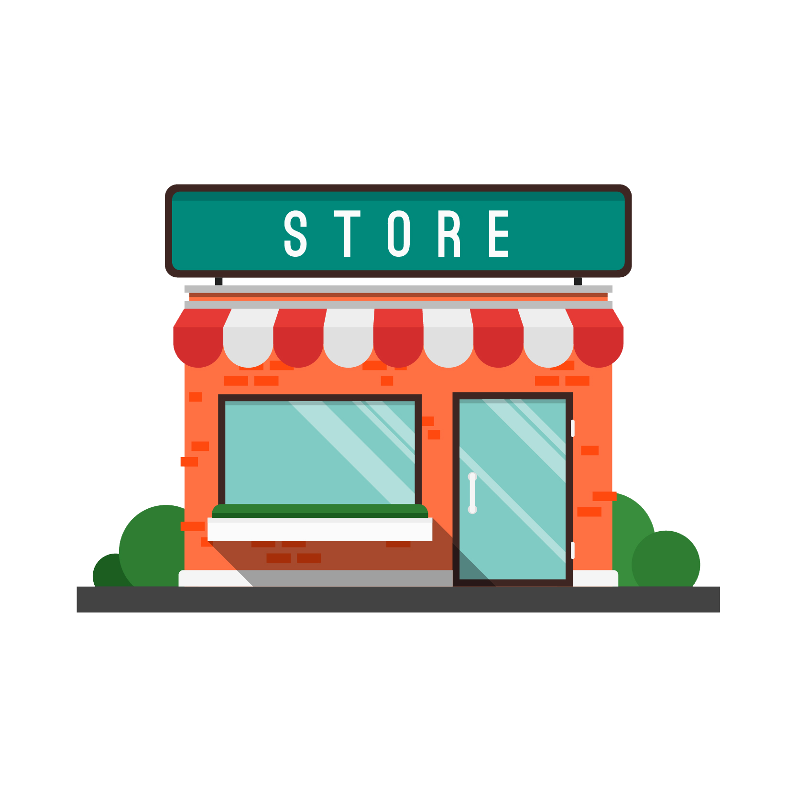

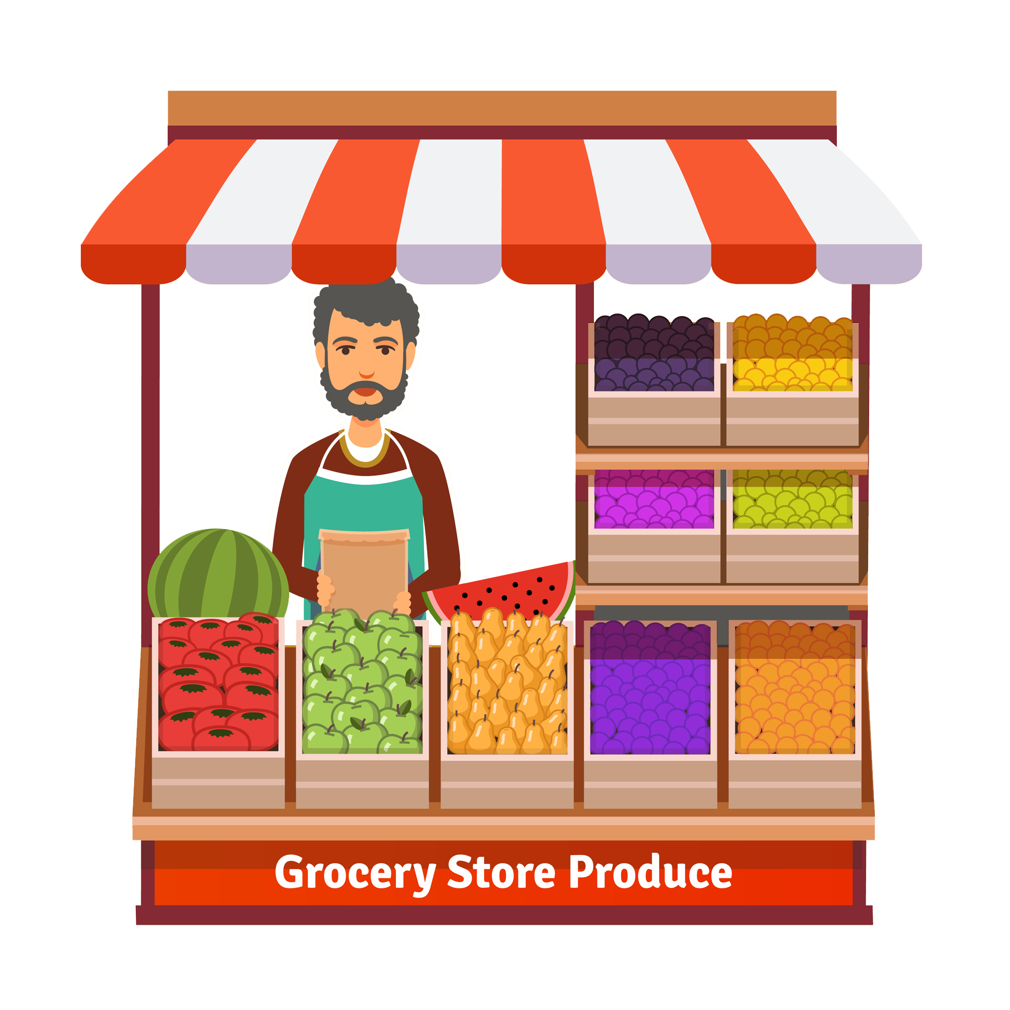
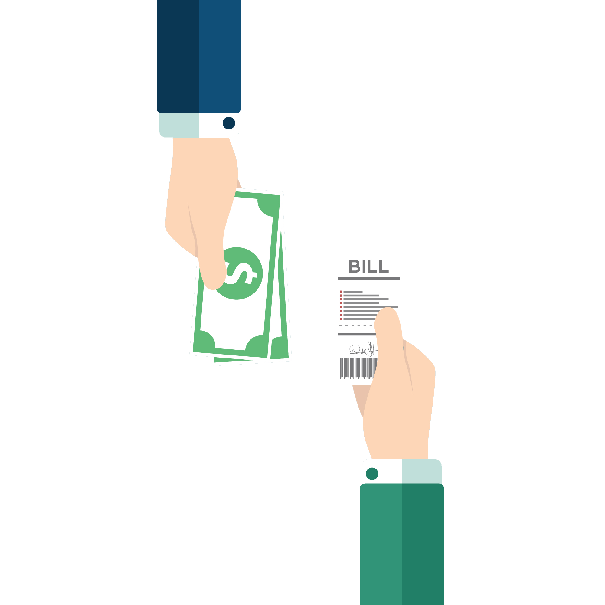
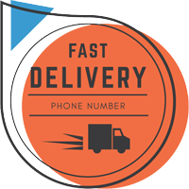
Enterprises
Marketplace Enterprise
Services
Stores
Customer
Each network then has following enterprises
Marketplace
Billing Shipment
Work Request as can be seen from diagram flows between the enterprises.
Billing
Shipment
Billing & Shipment Enterprise

Slide 5
Marketplace Enterprise
Grocery
💃
Clothing
Store Organization:
Let whatever be the type of Stores, if they are around you they are mentioned on the list with their products.
This application divides the stores into multiple categories based on the products they provide.
Stores
Drug Store
📖
Bookstore

Slide 6
🔨
Plumbing
👤
Handyman
Service Organization:
Each network then consist of one service organization which are responsible to serve all customers in one particular area.
This application also categorizes the services into Plumbing, Cleaning, Electrician, Carpenter,etc.
Services
Cleaning
🔌
Electrician

Slide 7
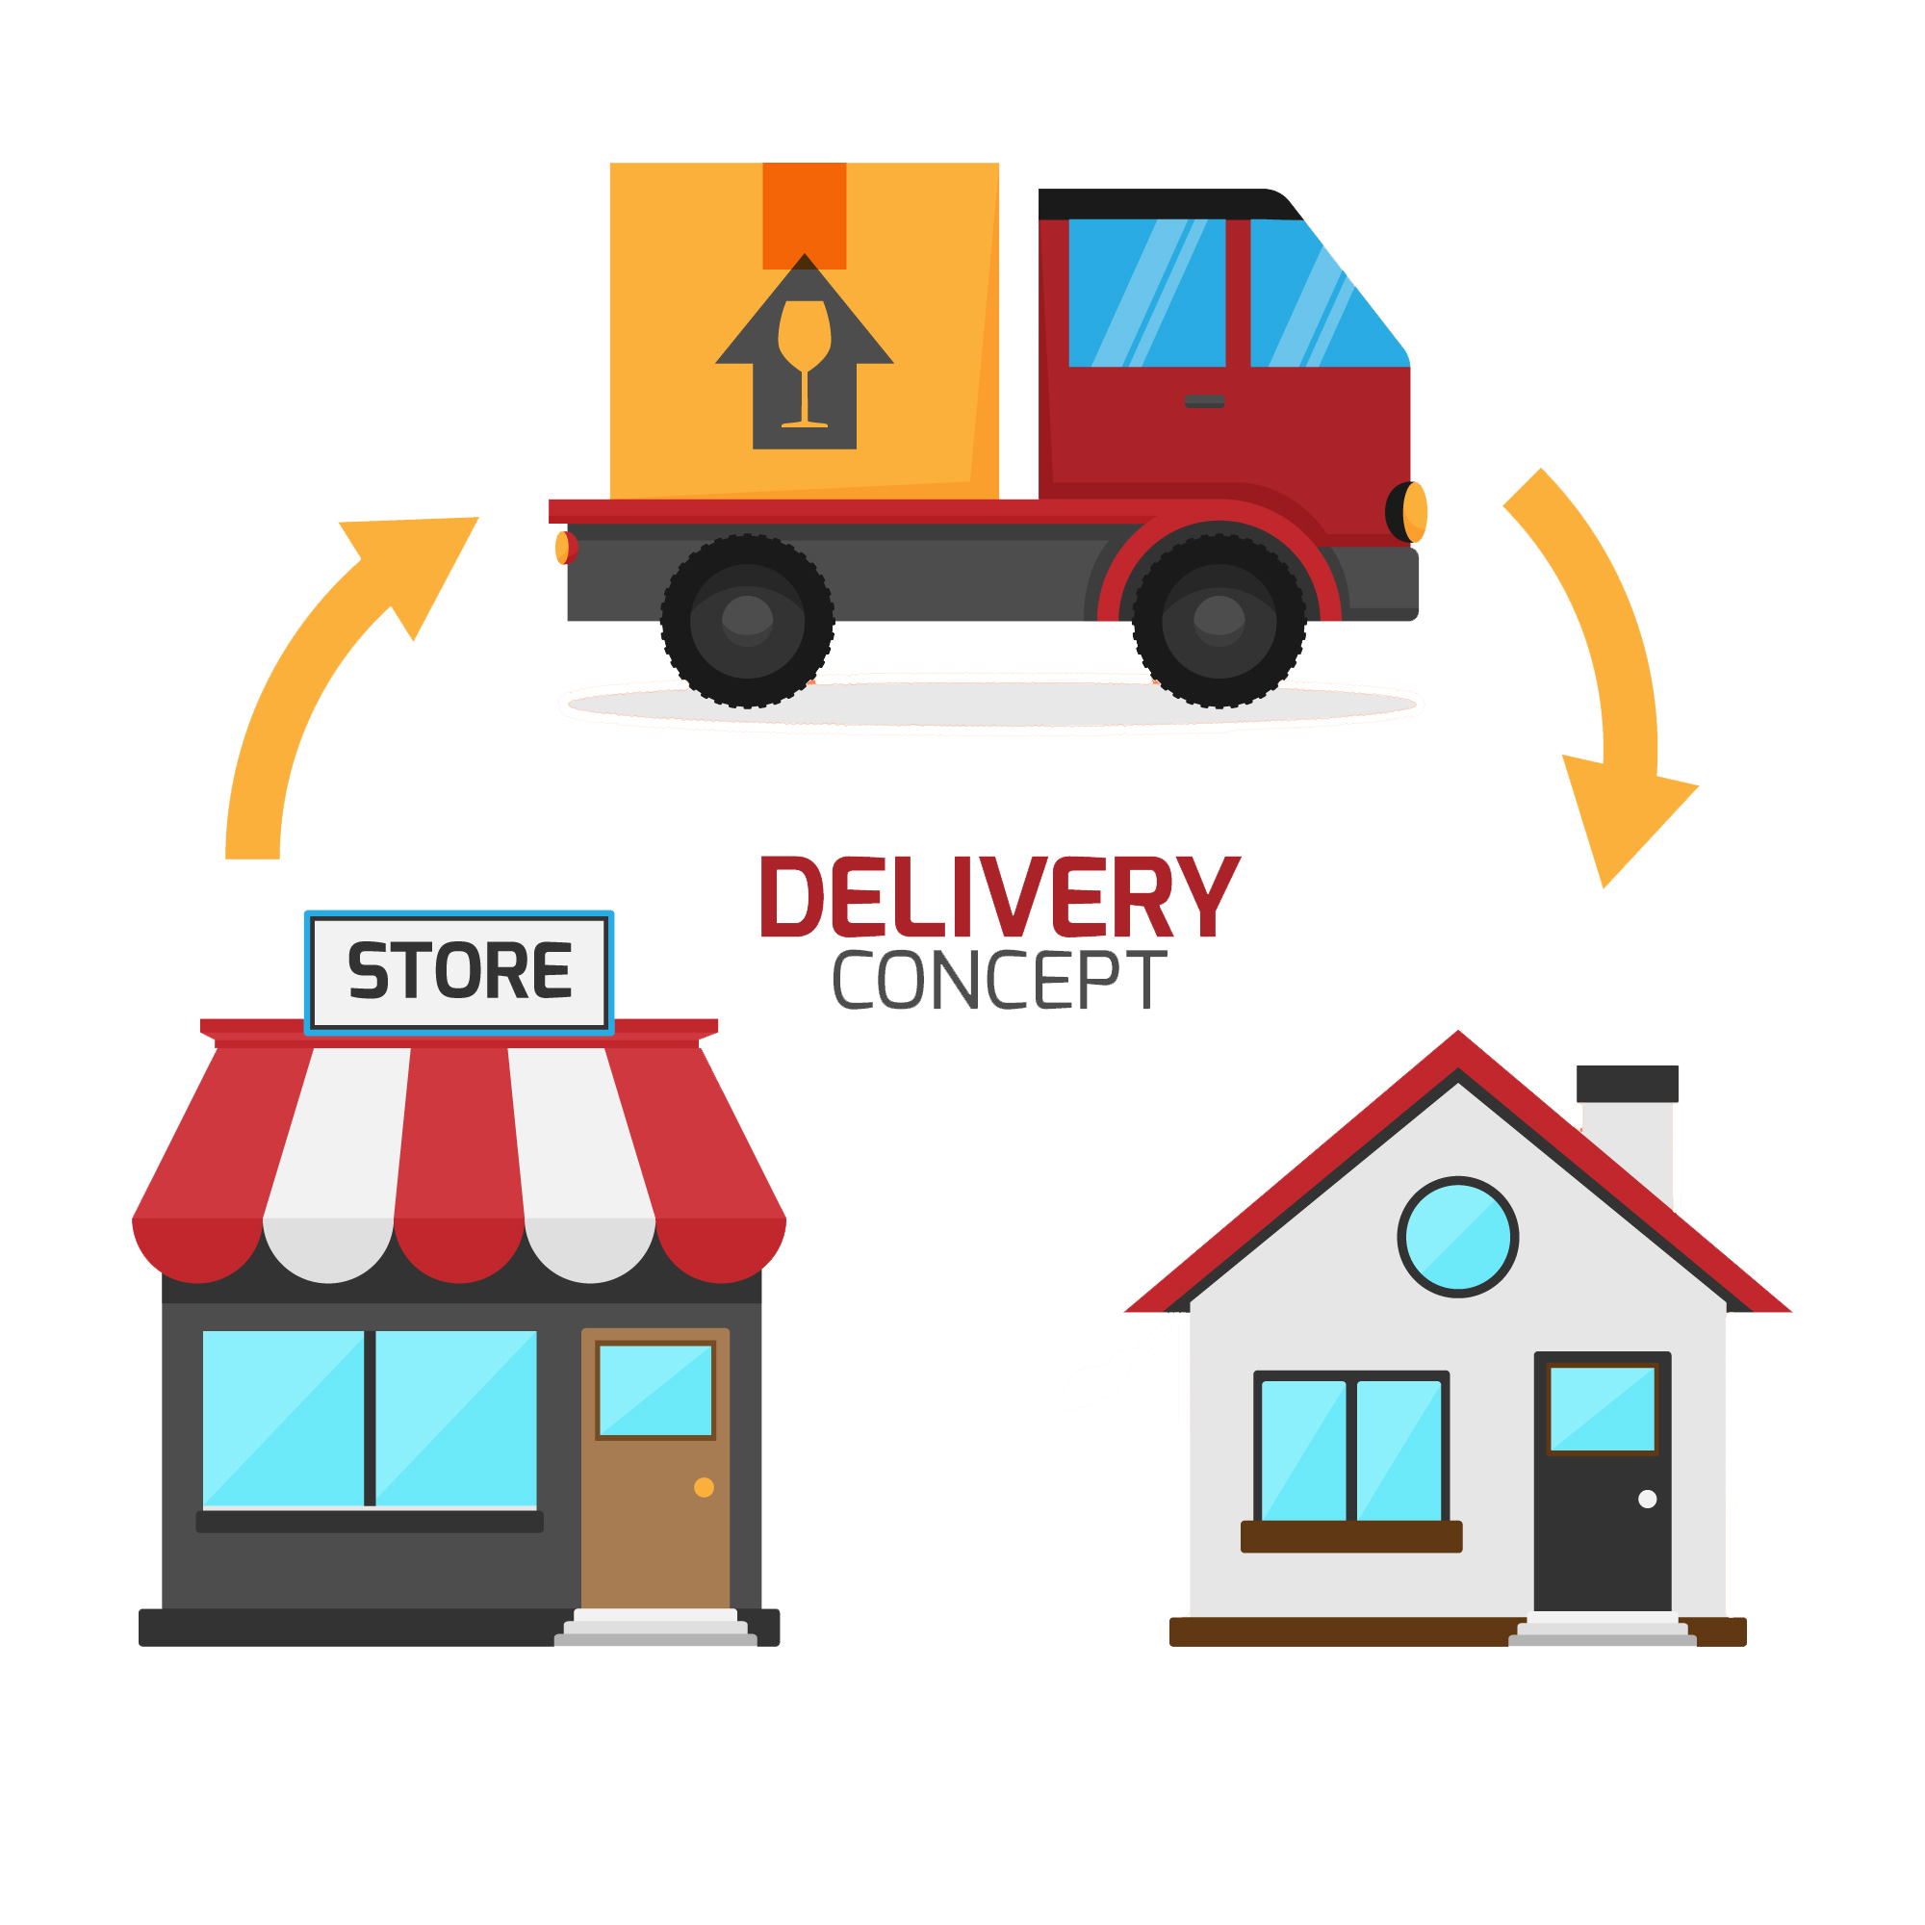

Billing & Shipment Enterprise
Shipment Organization:
Once a product has been ordered, the Store Manager then makes a request to the Shipment Manager to further proceed the process.
A Customer can either choose the Pick up option where the store reserves the product for the Customer to pickup. In this case the request doesn’t move to Shipment.
PICK UP

Slide 8
Billing Organization
Once a product has been ordered, the Service Manager then moves the request to billing
Billing Department is responsible for confirming and billing the order for a customer.

Slide 9
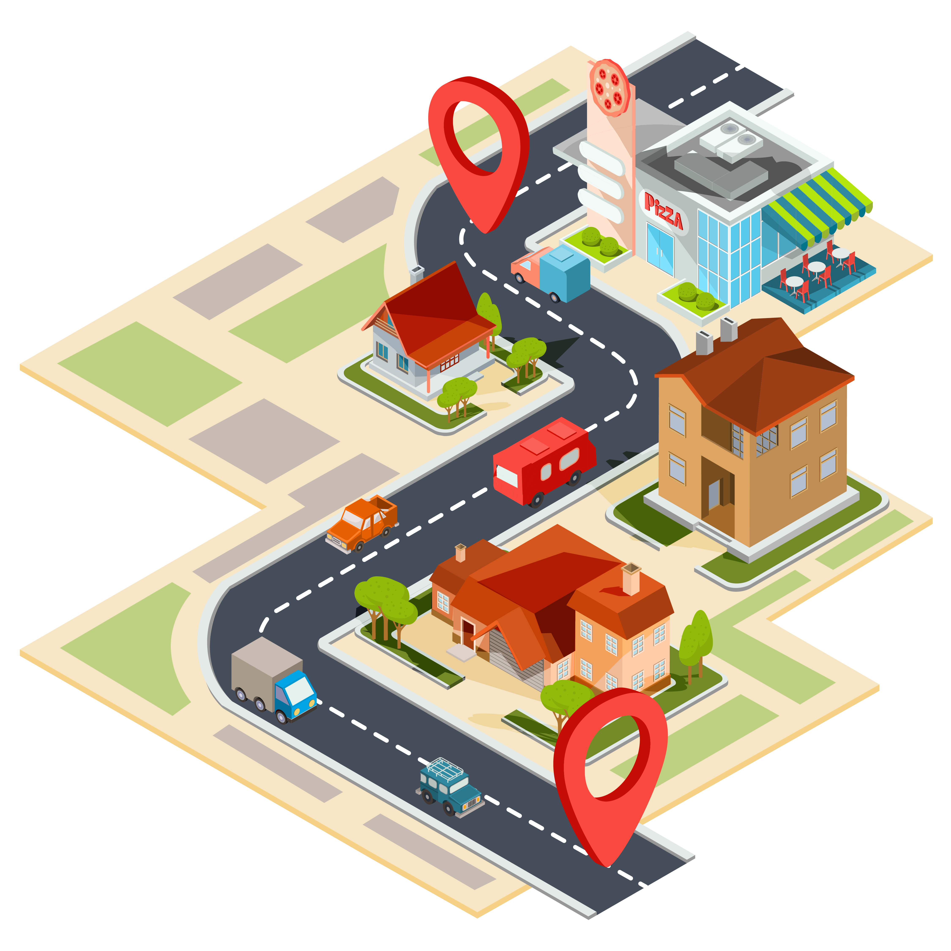
Customer
A Customer can either select a service or purchase stuff from stores nearby.
They can compare the stores having the same products present in different ranges.
They can also know the Services & Products available around them at cheaper rates.

Slide 10
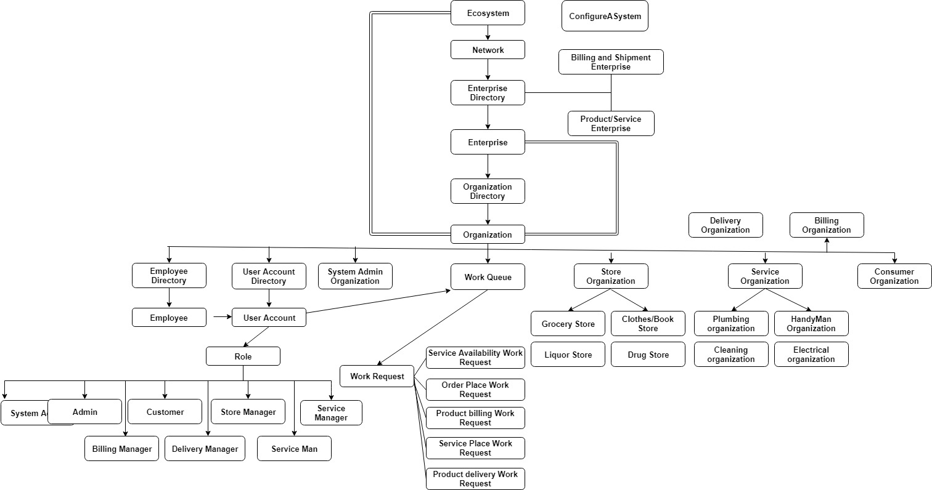
Object Model

Slide 11
Use Cases Actors
Admin
Manage Networks & Enterprises
Manage Organization
Manage Employees
Manage their Accounts
Store Manager
Manage Product Inventory
Update Product Price
Monitor Sales
Check Order
Service Manager
Managing Schedules and Calendars
Recruit Professional Employees
Manage Equipment
System Administrators
Store Manager
Service Manager
Customer
Delivery Manager
Billing Manager
Service Man
Customer
Order a Product
Request Schedules/Services
Compare Products
Compare Services
Shipment Manager
Manage Delivery of Products
Delivery comparison between providers
Ensures Delivery Confirmation
Billing Manager
Estimate Service Payments
Manage Billing Process
Confirm the payment

Slide 12
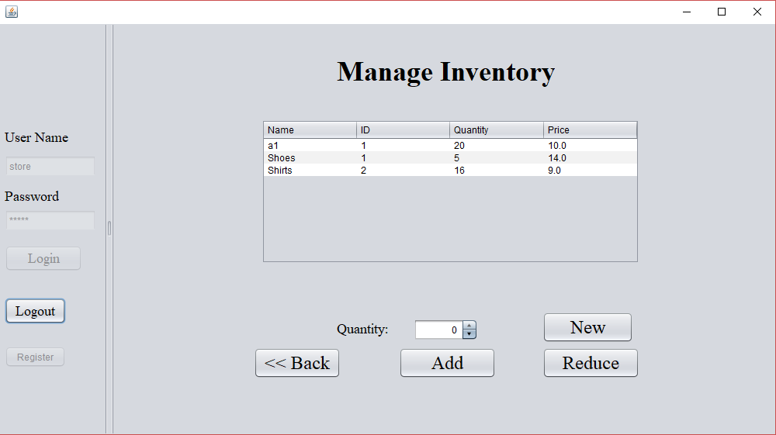
Project Demo

Slide 13
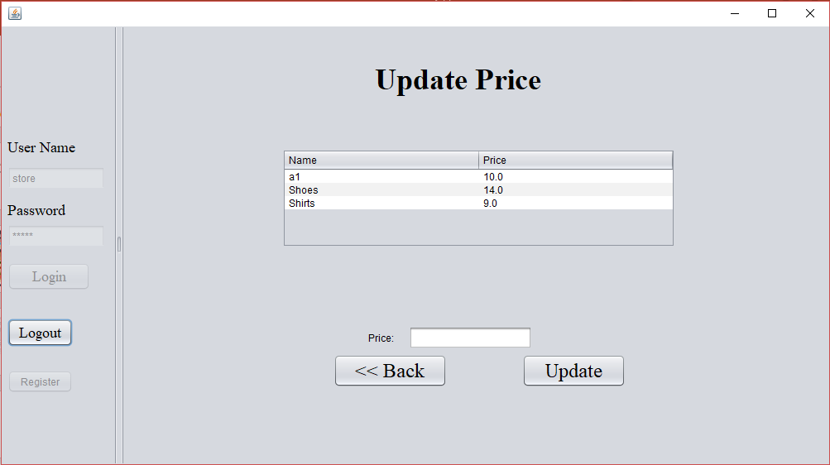

Slide 14
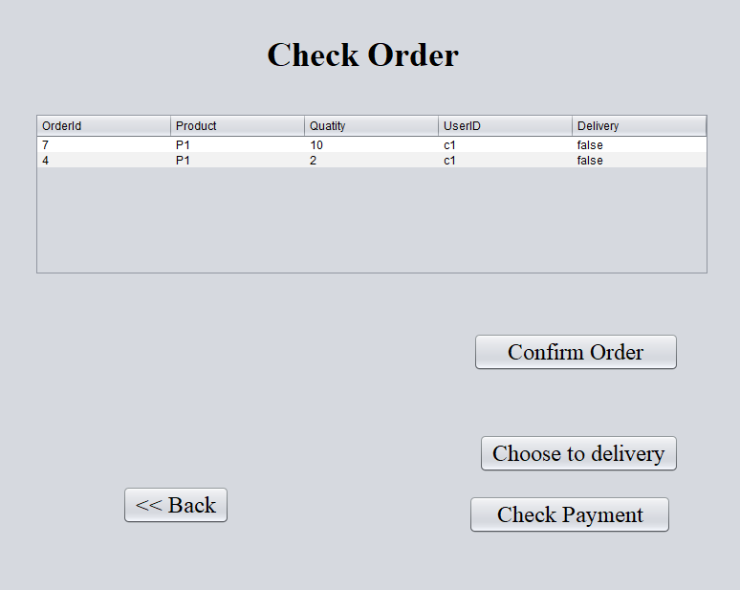

Slide 15
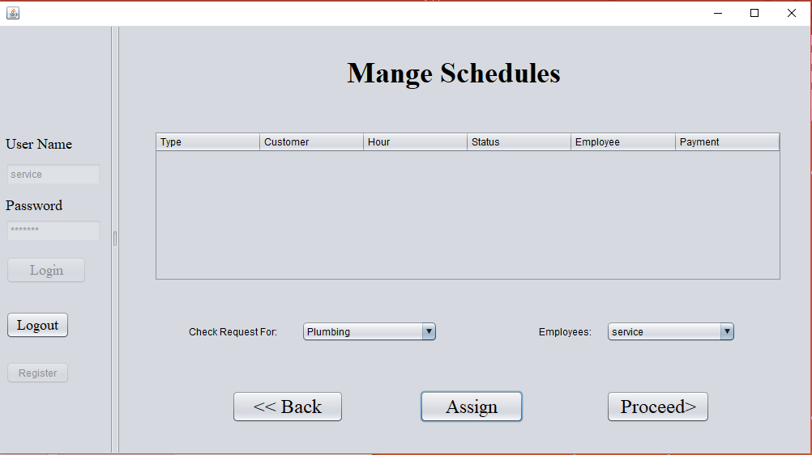

Slide 16
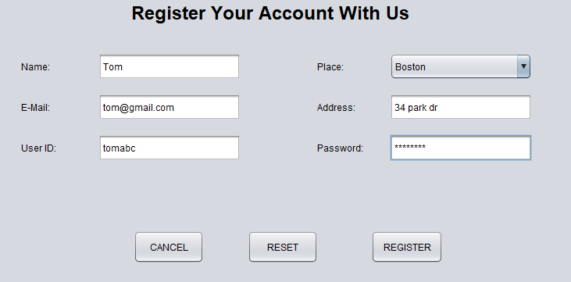

Slide 17
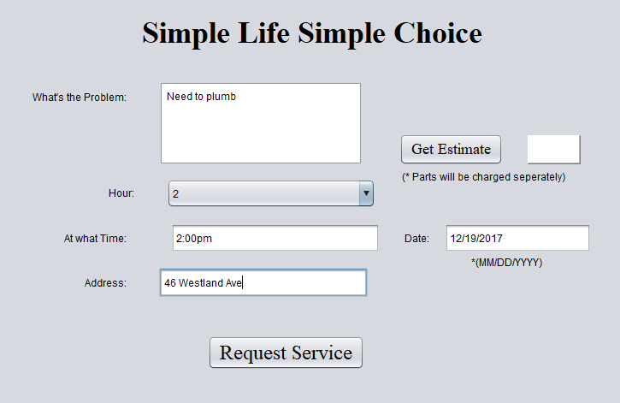

Slide 18
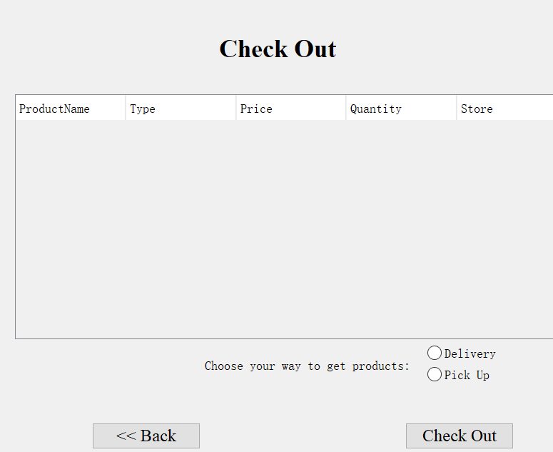

Slide 19
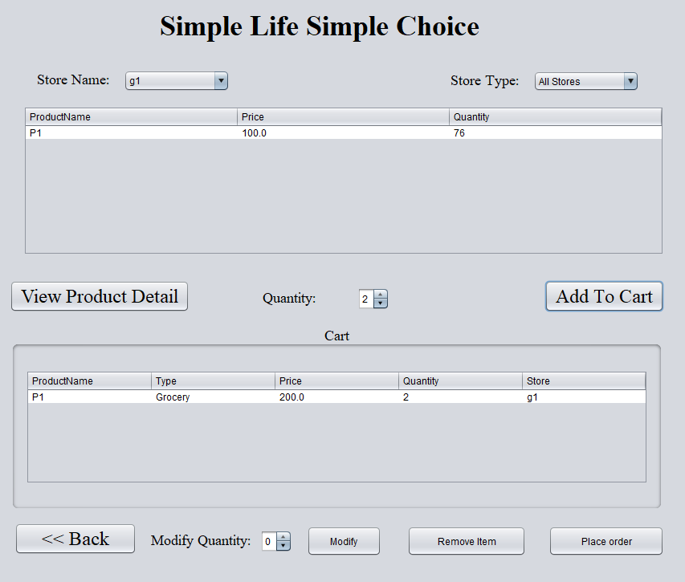

Slide 20
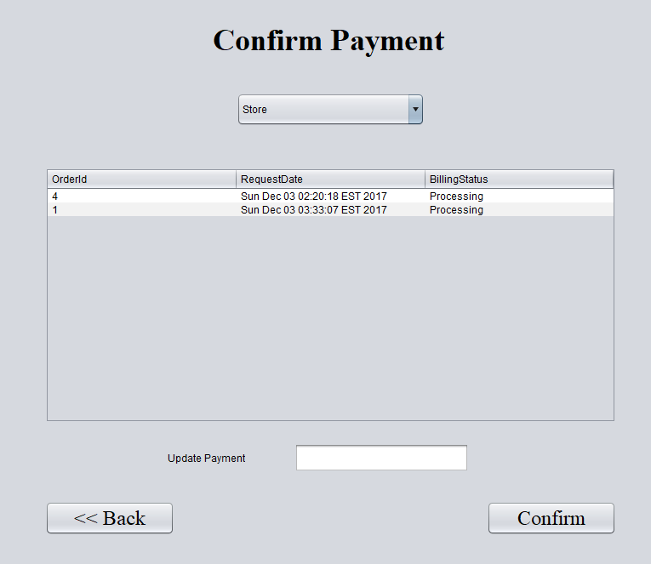

Slide 21
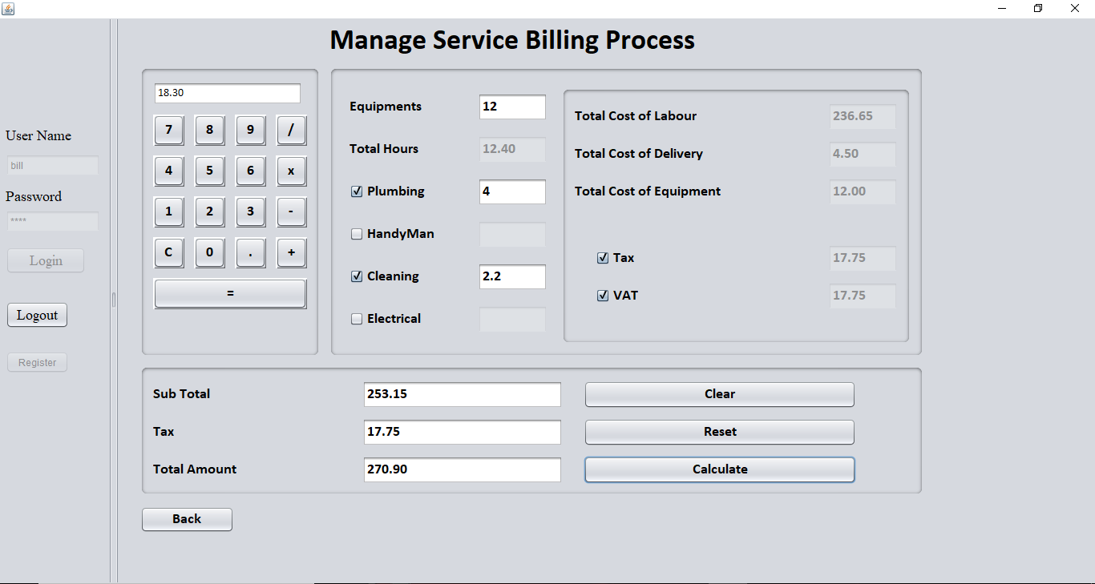

Slide 22
Thank you very much

